Slide 1

Space Y: Eliminating Space X
BY
Onkar Ajit Pawar
2nd MAY 2023

Slide 2
TABLE OF CONTENTS
1. Executive Summary
2. Introduction
3. Methodology
4. Results
5. Conclusion
6. Appendix

Slide 3
Executive Summary
Summary of methodologies:
Data Collection through API
Data Collection with Web Scraping
Data Wrangling
Exploratory Data Analysis with SQL
Exploratory Data Analysis with Data Visualization
Interactive Visual Analytics with Folium
Machine Learning Prediction
Summary of all results:
Exploratory Data Analysis result
Interactive analytics in screenshots
Predictive Analytics result

Slide 4
Introduction
The aim of this project is to predict whether the first stage of Space X's rocket launches will land successfully, which has significant cost implications. Compared to other providers who cost upward of 165 million dollars each, Space X advertises Falcon 9 rocket launches on its website for just 62 million dollars, largely due to the fact that they are able to reuse the first stage. By accurately predicting the success of these landings, we can help other companies determine their own launch costs and potentially gain a competitive edge in bidding against Space X.
Problems you want to find answers
What factors determine if the rocket will land successfully?
The interaction amongst various features that determine the success rate of a successful landing.
What operating conditions needs to be in place to ensure a successful landing program.

Slide 5
Section 1: Methodology

Slide 6
Methodology
1. Data collection methodology:
Data was collected using SpaceX API and web scraping from Wikipedia.
2. Perform data wrangling:
One-hot encoding was applied to categorical features
3. Perform exploratory data analysis (EDA) using visualization and SQL.
4.Perform interactive visual analytics using Folium and Plotly Dash
5. Perform predictive analysis using classification models
How to build, tune, evaluate classification models

Slide 7
Data Collection
The data was collected using various methods
Data collection was done using get request to the SpaceX API.
Next, we decoded the response content as a Json using .json() function call and turn it into a pandas dataframe using .json_normalize().
We then cleaned the data, checked for missing values and fill in missing values where necessary.
In addition, we performed web scraping from Wikipedia for Falcon 9 launch records with BeautifulSoup.
The objective was to extract the launch records as HTML table, parse the table and convert it to a pandas dataframe for future analysis.

Slide 8
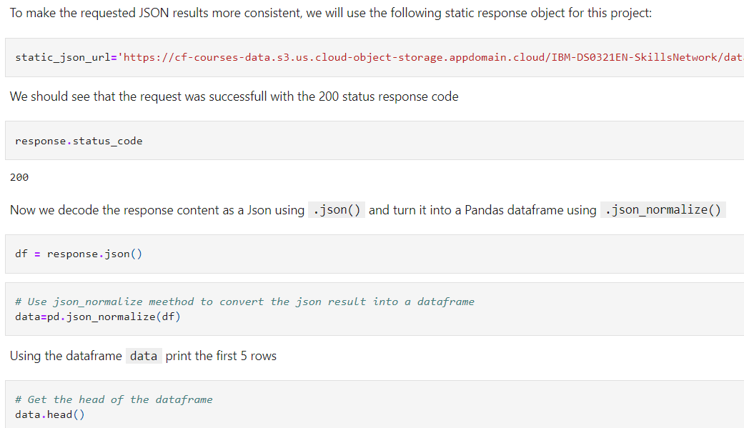
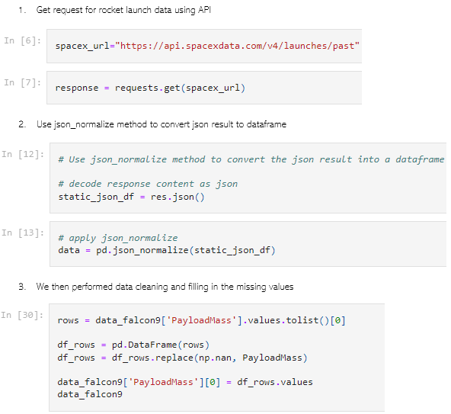
Data Collection – Using SpaceX API
We used the get request to the SpaceX API to collect data, clean the requested data and did some basic data wrangling and formatting.
The Link to the notebook is:
https://github.com/RealSteel1974/Space-Y-by-Allon-Musk-and-Onkar-Pawar/blob/main/jupyter-labs-spacex-data-collection-api.ipynb

Slide 9
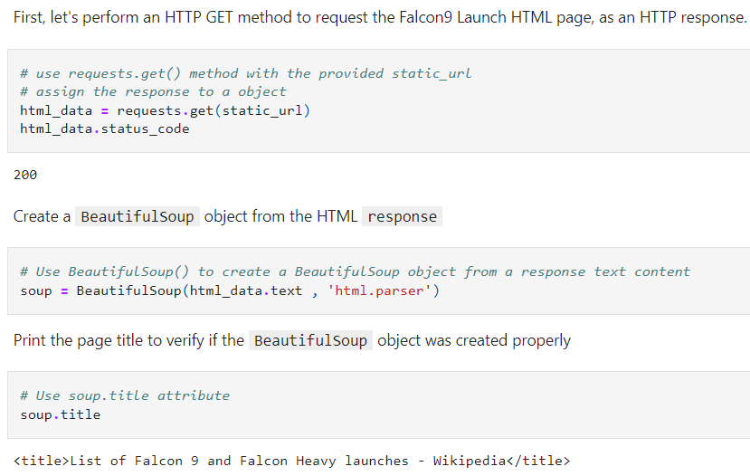
Data Collection – Scraping
We applied web scrapping to webscrap Falcon 9 launch records with BeautifulSoup
We parsed the table and converted it into a pandas dataframe.
The link to the notebook is https://github.com/RealSteel1974/Space-Y-by-Allon-Musk-and-Onkar-Pawar/blob/main/jupyter-labs-webscraping.ipynb

Slide 10
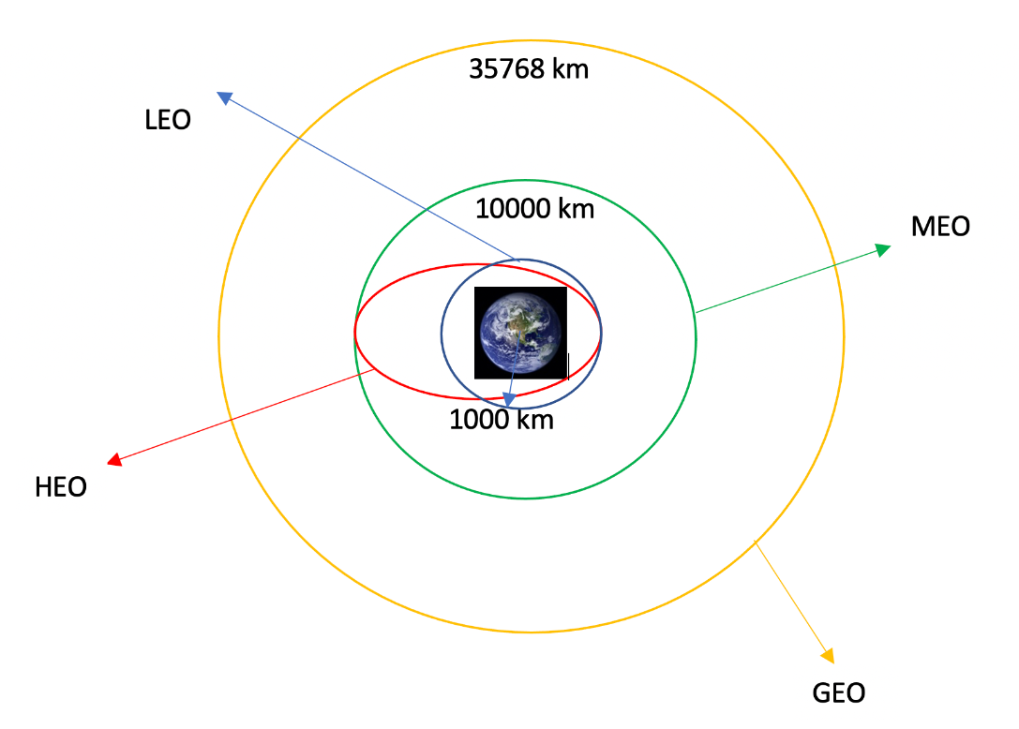
Data Wrangling
We performed exploratory data analysis and determined the training labels.
We calculated the number of launches at each site, and the number and occurrence of each orbits
We created landing outcome label from outcome column and exported the results to csv.
The link to the notebook is https://github.com/RealSteel1974/Space-Y-by-Allon-Musk-and-Onkar-Pawar/blob/main/IBM-DS0321EN-SkillsNetwork_labs_module_1_L3_labs-jupyter-spacex-data_wrangling_jupyterlite.jupyterlite.ipynb

Slide 11
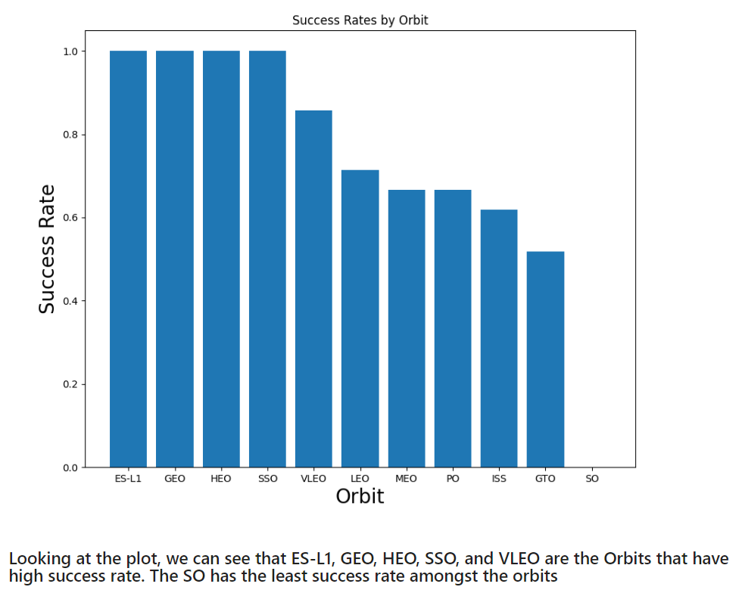
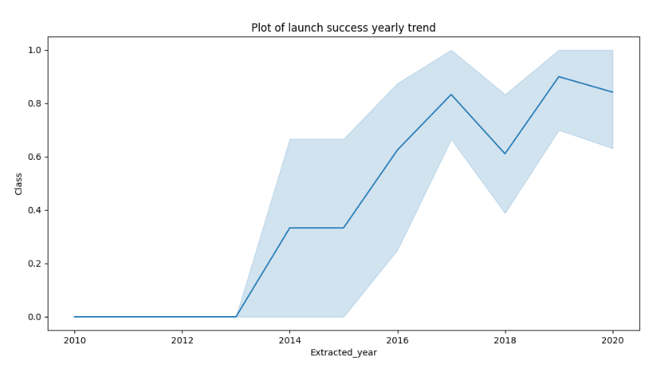
EDA with Data Visualization
We performed exploratory data analysis and determined the training labels.
We calculated the number of launches at each site, and the number and occurrence of each orbits
We created landing outcome label from outcome column and exported the results to csv.
The link to the notebook is https://github.com/RealSteel1974/Space-Y-by-Allon-Musk-and-Onkar-Pawar/blob/main/IBM-DS0321EN-SkillsNetwork_labs_module_2_jupyter-labs-eda-dataviz.ipynb.jupyterlite.ipynb

Slide 12
EDA with SQL
We loaded the SpaceX dataset into a PostgreSQL database without leaving the jupyter notebook.
We applied EDA with SQL to get insight from the data. We wrote queries to find out for instance:
-The names of unique launch sites in the space mission.
-The total payload mass carried by boosters launched by NASA (CRS)
-The average payload mass carried by booster version F9 v1.1
-The total number of successful and failure mission outcomes
-The failed landing outcomes in drone ship, their booster version and launch site names.
The link to the notebook is
https://github.com/RealSteel1974/Space-Y-by-Allon-Musk-and-Onkar-Pawar/blob/main/jupyter-labs-eda-sql-coursera_sqllite.ipynb

Slide 13
Build a Interactive Map with Folium
We marked all launch sites, and added map objects such as markers, circles, lines to mark the success or failure of launches for each site on the folium map.
We assigned the feature launch outcomes (failure or success) to class 0 and 1.i.e., 0 for failure, and 1 for success.
Using the color-labeled marker clusters, we identified which launch sites have relatively high success rate.
We calculated the distances between a launch site to its proximities. We answered some question for instance:
-Are launch sites near railways, highways and coastlines.
-Do launch sites keep certain distance away from cities.

Slide 14
Build a Dashboard with Plotly Dash
We built an interactive dashboard with Plotly dash
We plotted pie charts showing the total launches by a certain sites
We plotted scatter graph showing the relationship with Outcome and Payload Mass (Kg) for the different booster version.
The link to the notebook is https://github.com/RealSteel1974/Space-Y-by-Allon-Musk-and-Onkar-Pawar/blob/main/spacex_dash_app.py
.

Slide 15
Predictive Analysis (Classification)
The link to the now we loaded the data using numpy and pandas, transformed the data, split our data into training and testing.
We built different machine learning models and tune different hyperparameters using GridSearchCV.
We used accuracy as the metric for our model, improved the model using feature engineering and algorithm tuning.
We found the best performing classification model.
The link to the notebook is https://github.com/RealSteel1974/Space-Y-by-Allon-Musk-and-Onkar-Pawar/blob/main/IBM-DS0321EN-SkillsNetwork_labs_module_4_SpaceX_Machine_Learning_Prediction_Part_5.jupyterlite.ipynb

Slide 16
Exploratory data analysis results
Interactive analytics demo in screenshots
Predictive analysis results

Slide 17
Section 2: Insights drawn from EDA

Slide 18
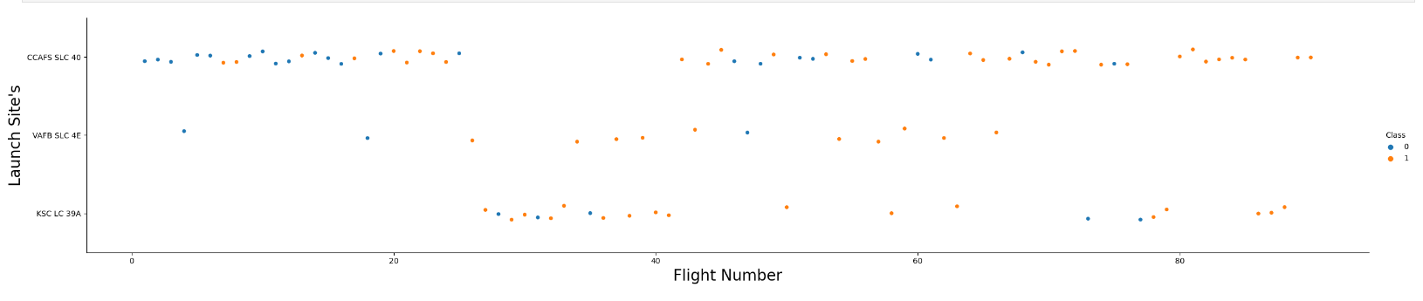
Flight Number vs. Launch Site
From the plot, we Infer that the larger the flight amount at a launch site, the greater the success rate at a launch site.
we can observe as the flight number increases the success rate increases too

Slide 19
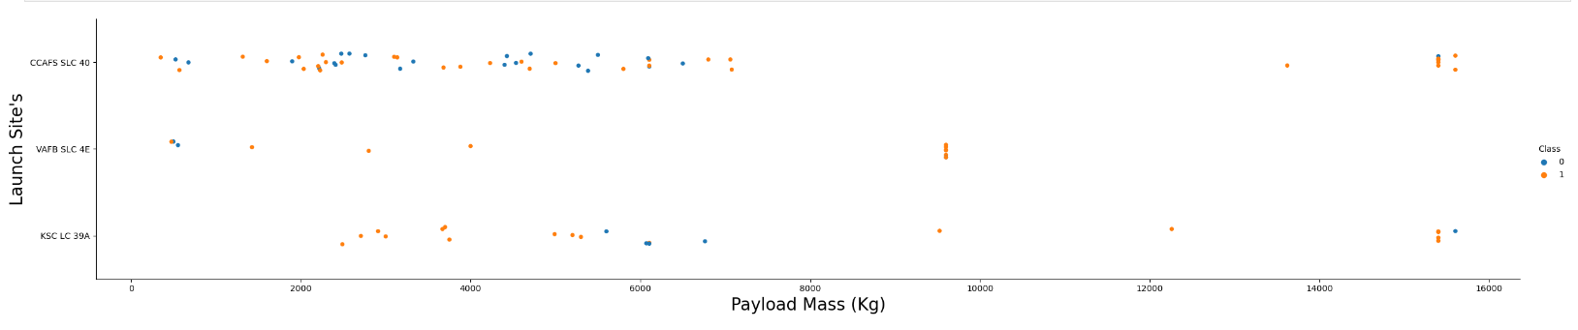
Payload vs. Launch Site

Slide 20
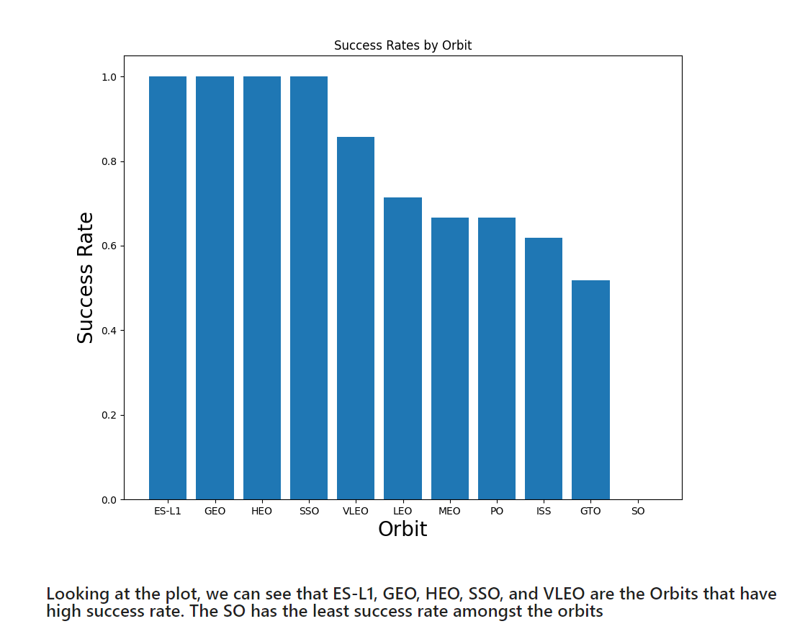
Success Rate vs. Orbit Type

Slide 21
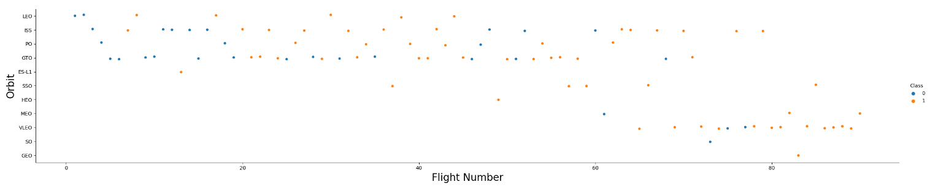
Flight Number vs. Orbit Type

Slide 22
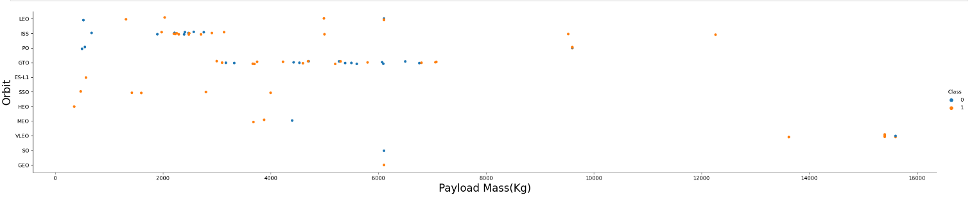
Payload (kg) vs. Orbit Type

Slide 23
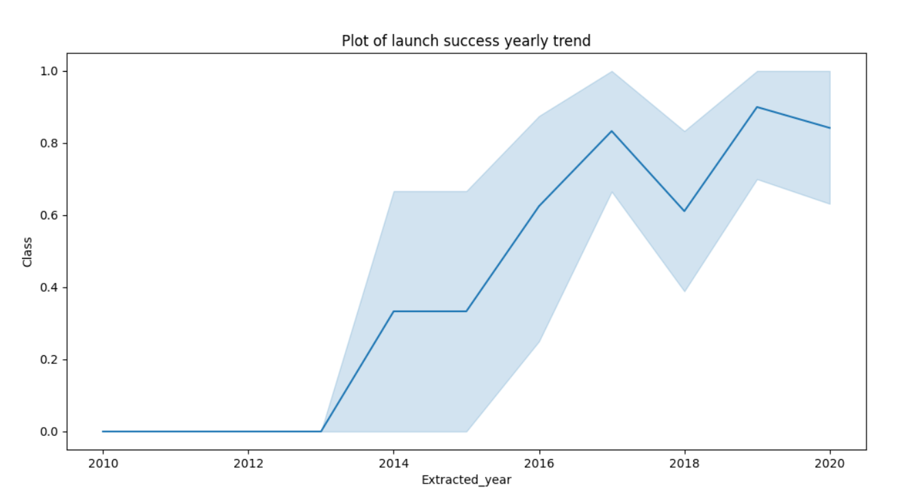
Launch Success Yearly Trend
From the plot, we can observe that success rate since 2013 kept on increasing till 2020

Slide 24
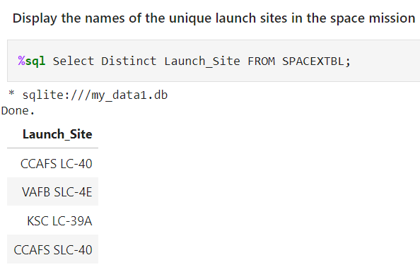
All Launch Sites NAmes
We used the key word DISTINCT to show only unique launch sites from the SpaceX data.

Slide 25
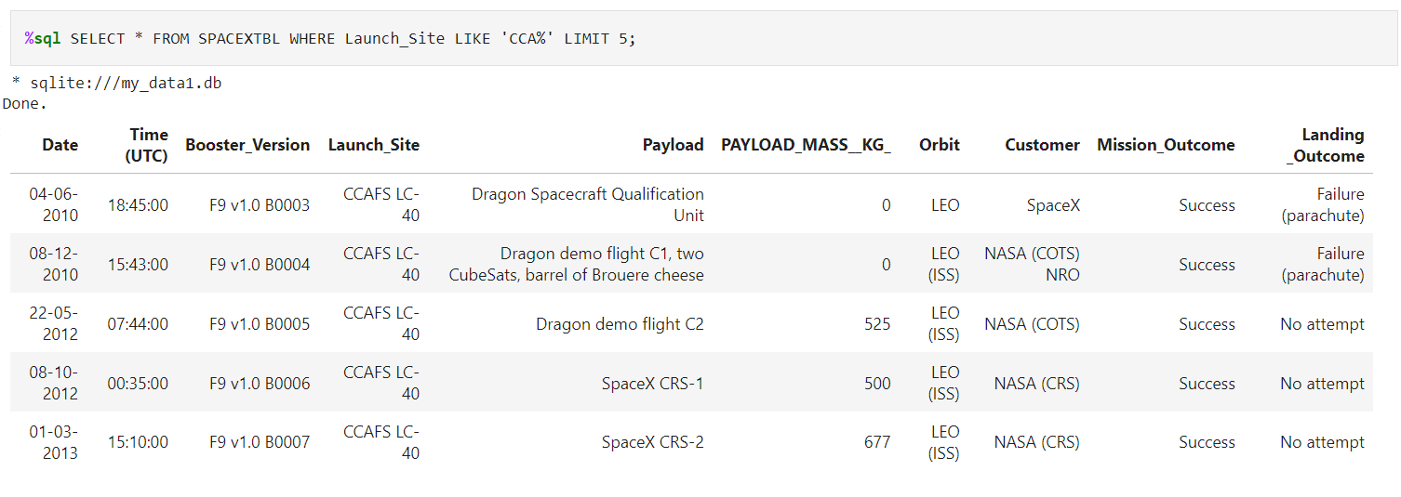
Launch Sites Names begin with ‘CAA’
We used the query above to display 5 records where launch sites begin with `CCA`

Slide 26
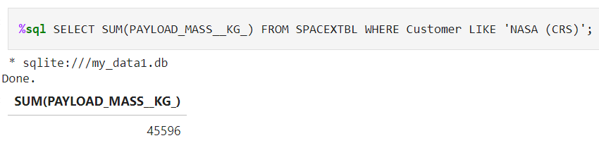
Total Payload Mass
We calculated the total payload carried by boosters from NASA as 45596 using the query below

Slide 27
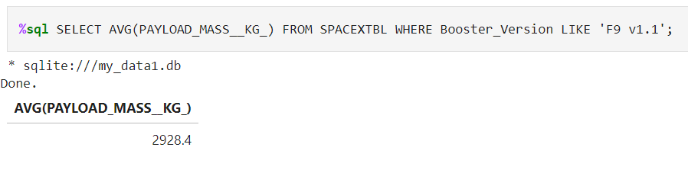
Average Payload Mass by F9 v1.1
We calculated the average payload mass carried by booster version F9 v1.1 as 2928.4

Slide 28
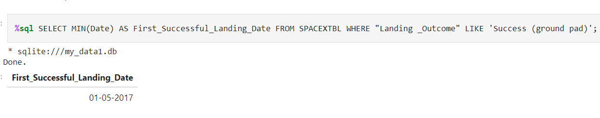
First Successful Ground Landing Date
We observed that the dates of the first successful landing outcome on ground pad was 22nd December 2015
.

Slide 29
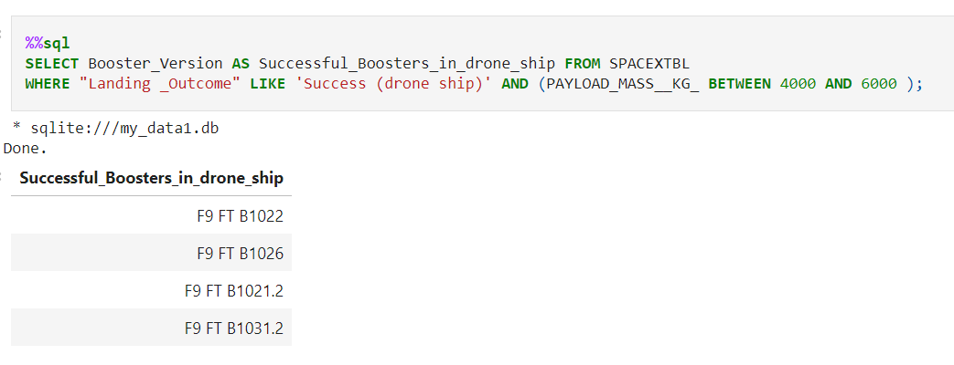
Successful Drone Ship Landing with Payload between 4000 and 6000

Slide 30
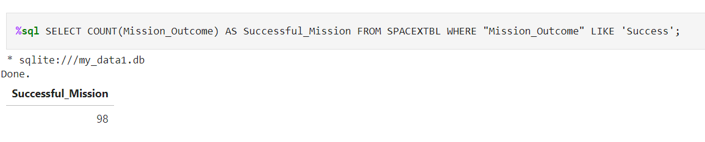
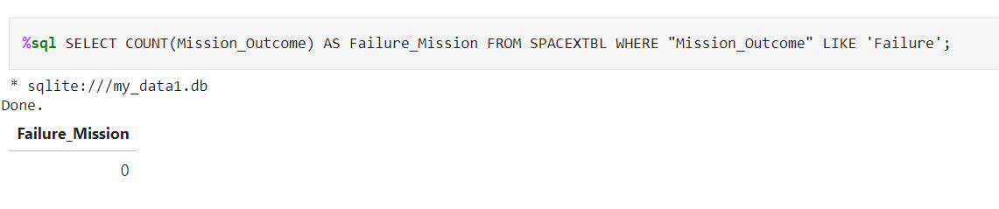
Total Number of Successful and Failure Mission Outcomes
We used wildcard like ‘%’ to filter for WHERE Mission_Outcome was a success or a failure.

Slide 31
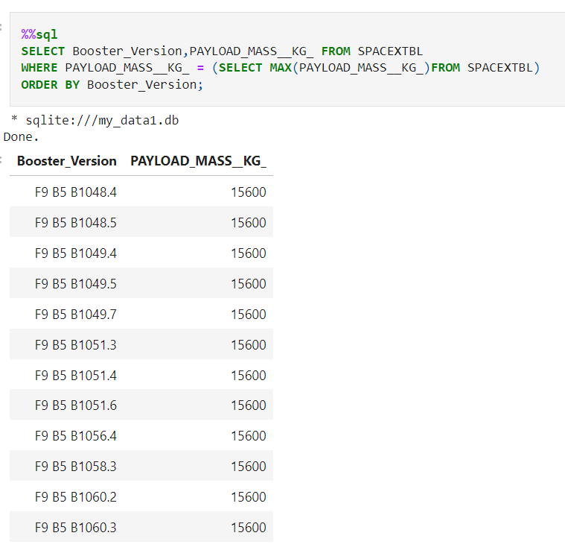
Boosters Carried Maximum Payload
We determined the booster that have carried the maximum payload using a subquery in the WHERE clause and the MAX() function.
.

Slide 32
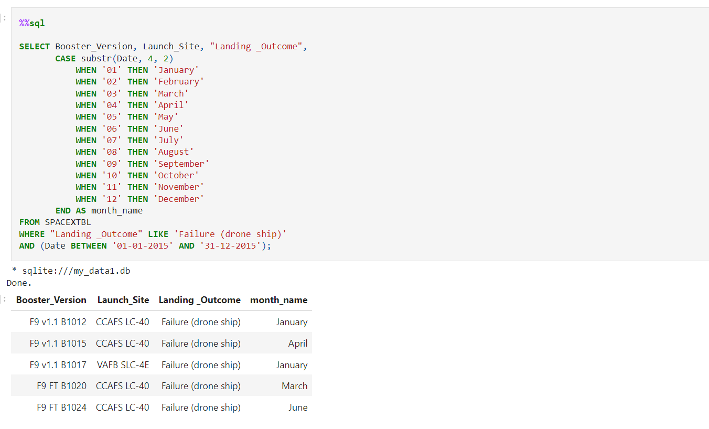
2015 Launch Records
display the month names, failure landing_outcomes in drone ship ,booster versions, launch_site for the months in year 2015.

Slide 33
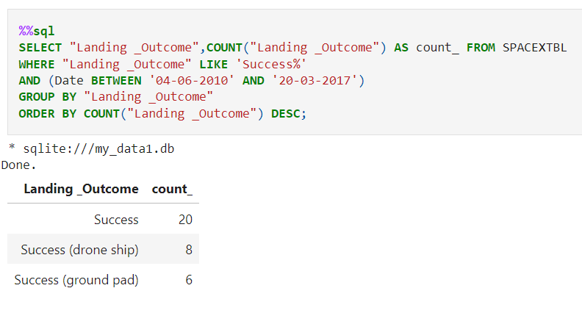
Ranking successful landing_outcomes between the date 04-06-2010 and 20-03-2017 in descending order
We selected Landing outcomes and the COUNT of landing outcomes from the data and used the WHERE clause to filter for landing outcomes BETWEEN 2010-06-04 to 2010-03-20.
We applied the GROUP BY clause to group the landing outcomes and the ORDER BY clause to order the grouped landing outcome in descending order..

Slide 34
Section 3: Launch Sites Proximities Analysis

Slide 35
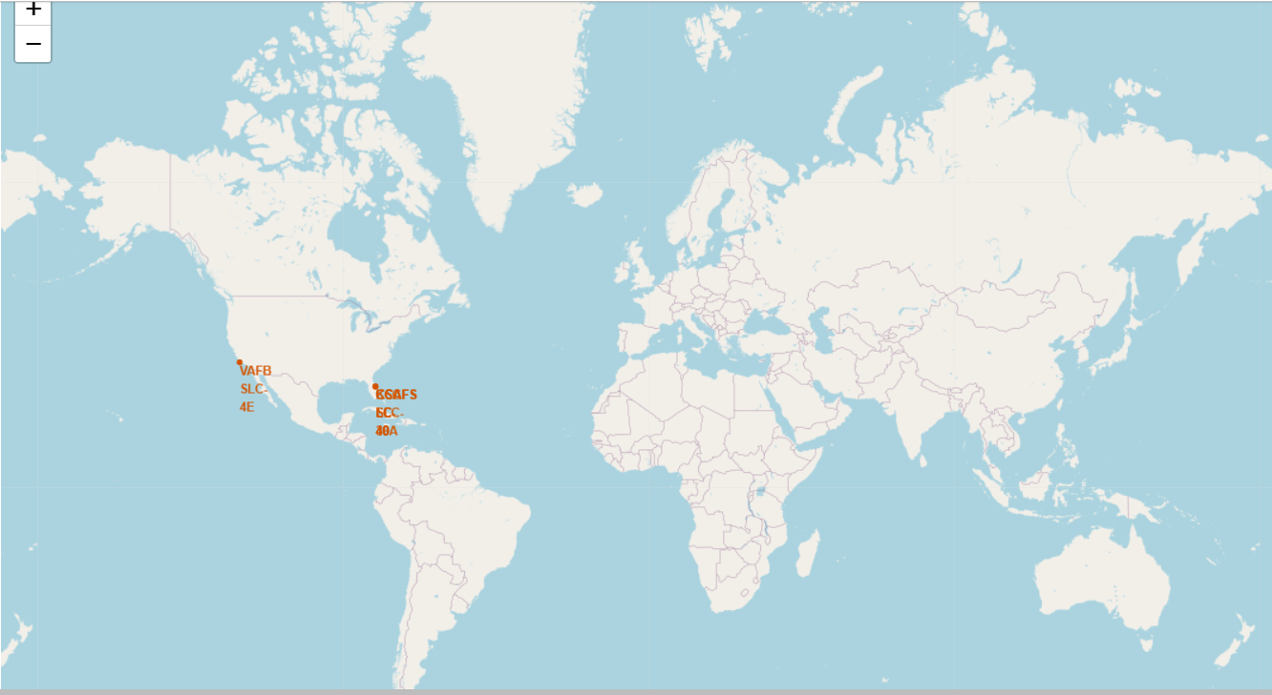
All Launch Sites global map Markers
3 of the launch sites are placed in close vicinity in which 2 are neighbors, and just one launch site is to the west of USA

Slide 36
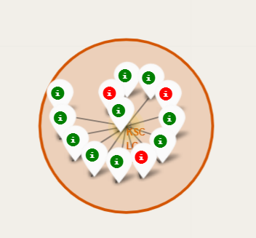
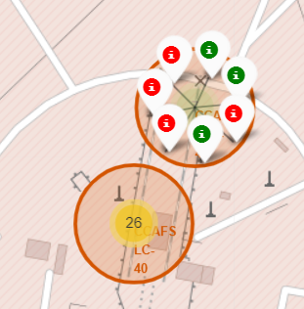
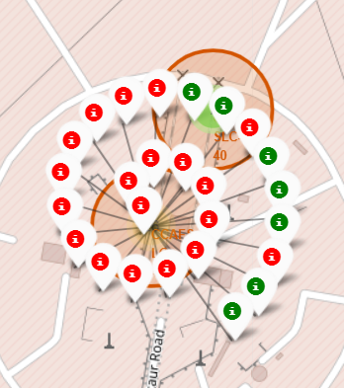
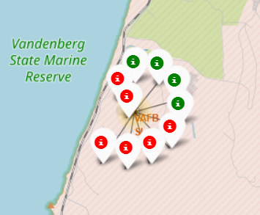
Markers showing launch sites with color labels
Green Marker - Successful Launches
Red Marker - Failures
California Launch Site

Slide 37
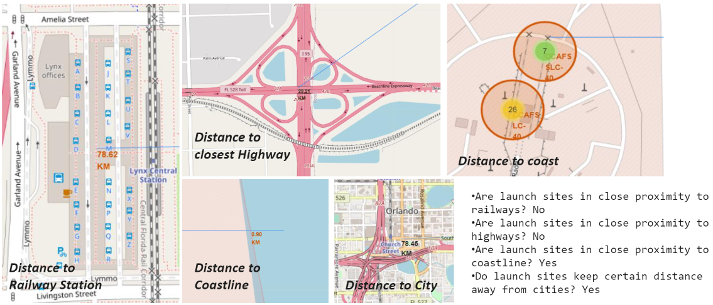
launch sites Distance to LAndmarks

Slide 38
Section 4: Build a Dashboard with Plotly Dash

Slide 39
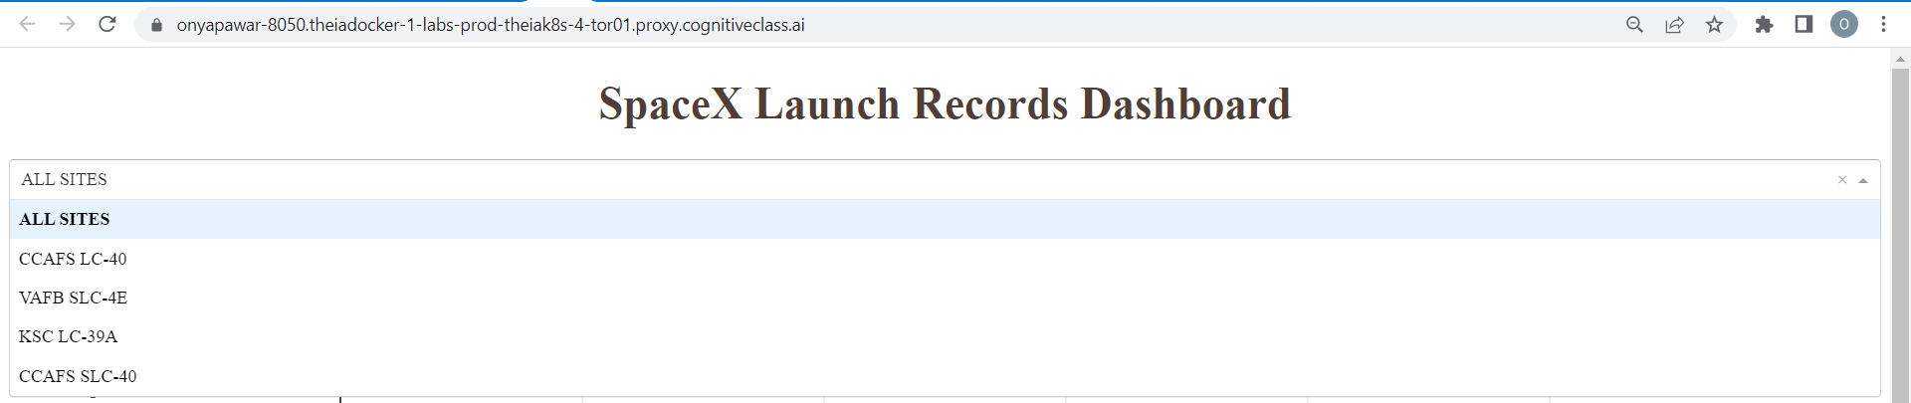

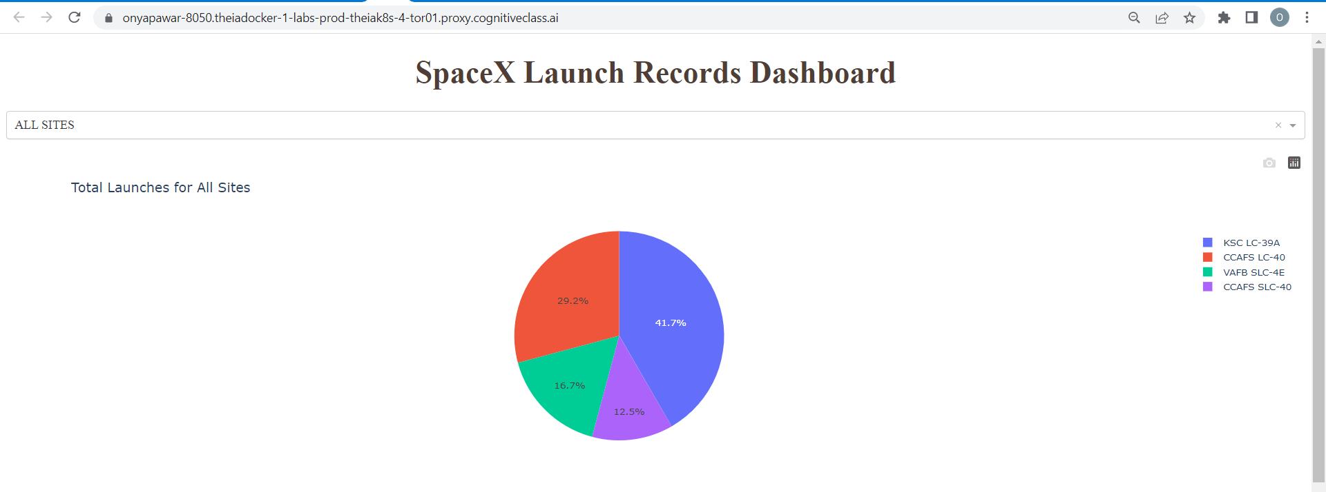
Pie Chart showing percentage achieved by each Launch Site

Slide 40
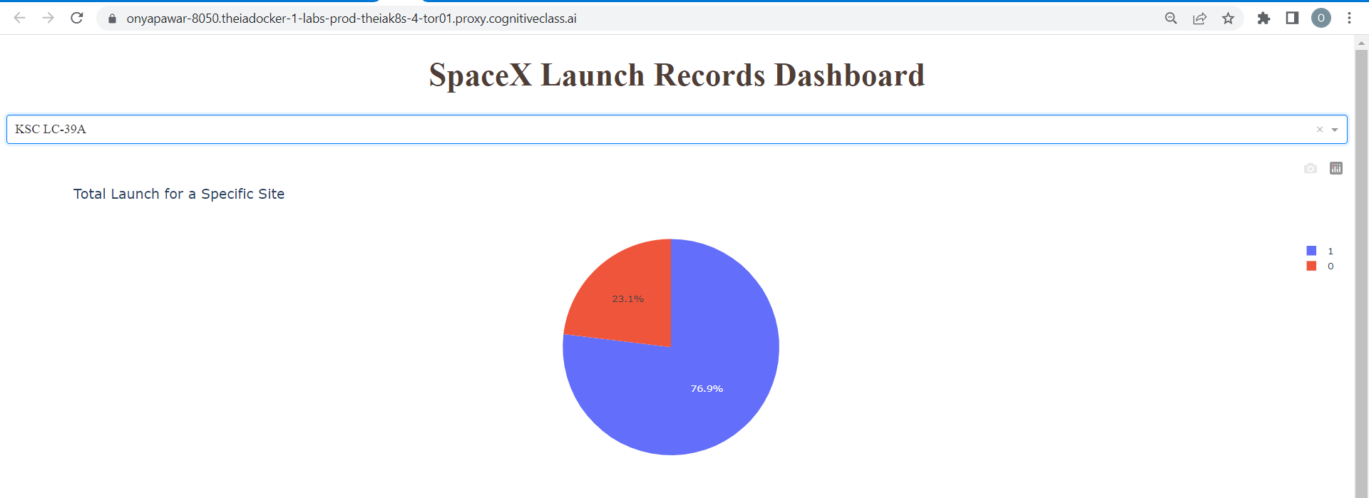
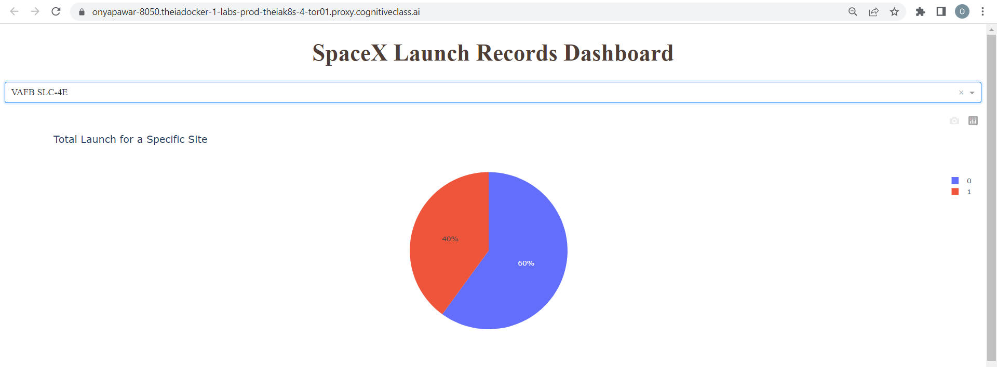
Pie Chart showing Launch Site with Highest Launch Success Ratio

Slide 41
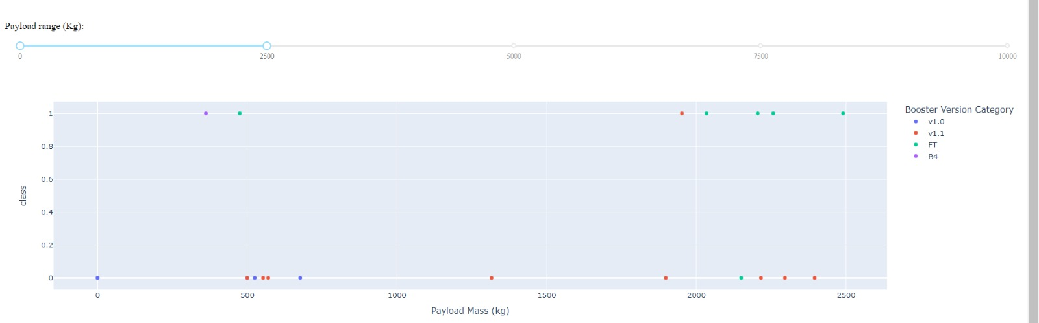
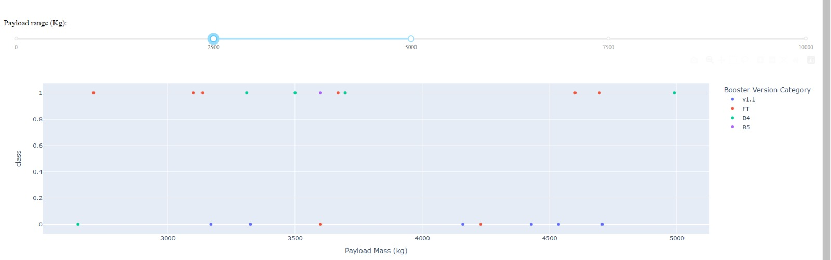
Scatter plot of Payload vs Launch Outcome for all sites, with different payload selected in the range slider
0-2500Kg
2500-5000Kg

Slide 42
Section 5: Predictive Analysis (Classifaction)

Slide 43

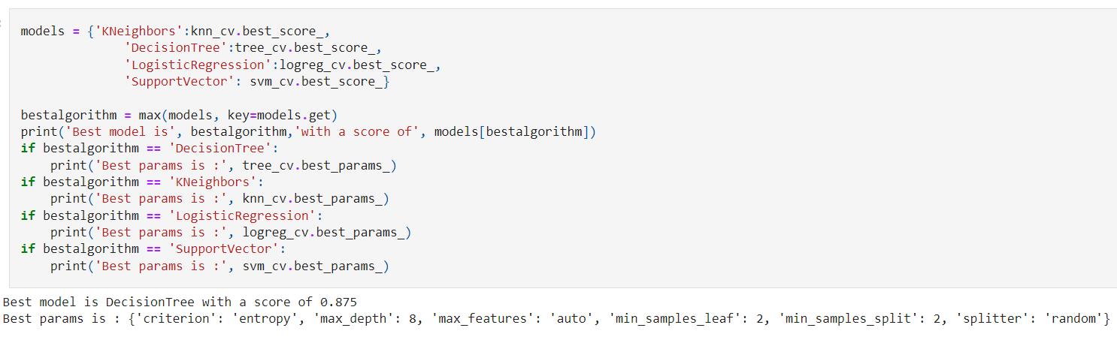
Classification Accuracy

Slide 44
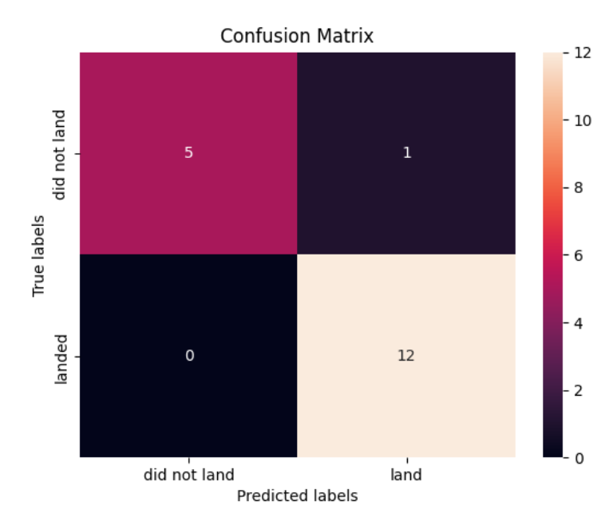
Confusion Matrix
The confusion matrix for the decision tree classifier shows that the classifier can distinguish between the different classes. The major problem is the false positives .i.e., unsuccessful landing marked as successful landing by the classifier.

Slide 45
Conclusion
We can conclude that:
The larger the flight amount at a launch site, the greater the success rate at a launch site.
Launch success rate started to increase in 2013 till 2020.
Orbits ES-L1, GEO, HEO, SSO, VLEO had the most success rate.
KSC LC-39A had the most successful launches of any sites.
The Decision tree classifier is the best machine learning algorithm for this task.

Slide 46
Section 6: Appendix

Slide 47
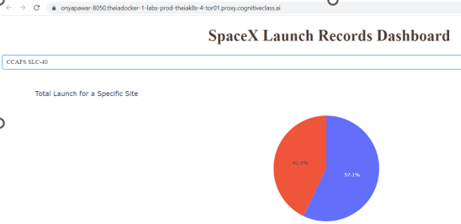
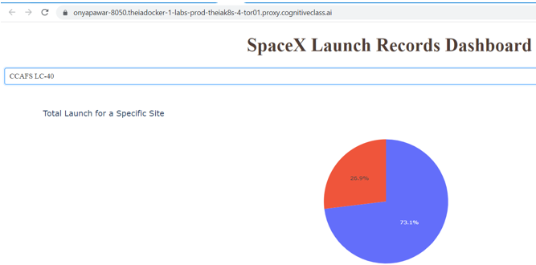
Pie Chart showing Launch Site with Other Launch Success Ratio

Slide 48
Production Team
-Publishing: Grace Barker, Rachael Jones
-Project Coordinators: Kathleen Bergner
-Narration: Bella West
-Video Production: Simer Preet, Lauren Hall, Hunter Bay, Tanya -Singh, Om Singh
Credits and Acknowledgments
Primary Instructors
-Joseph Santarcangelo
-Yan Luo
Other Contributors & Staff
-Project Lead: Rav Ahuja
-Instructional Designer: Lakshmi Holla
-Lab Authors: Joseph Santarcangelo, Yan Luo, Azim Hirjani, -Lakshmi Holla
-Technical Advisor: Yan Luo
Teaching Assistants and Forum Moderators
-Malika Singla
-Duvvana Mrutyunjaya Naidu
-Lakshmi Holla
-Anita Verma

Slide 49
THANKS You!

